Slide 1

Designing optimal Co-cure Process OF honeycomb SANDWICH structure with Machine Learning Models
Mohammed Al-Fahdi,
Sowmya Raghu,
Ph.D. Students
Department of Mechanical Engineering

Slide 2
OUTLINE
The Problem
The Dataset
Objectives
Our Approach
Results and Discussion

Slide 3
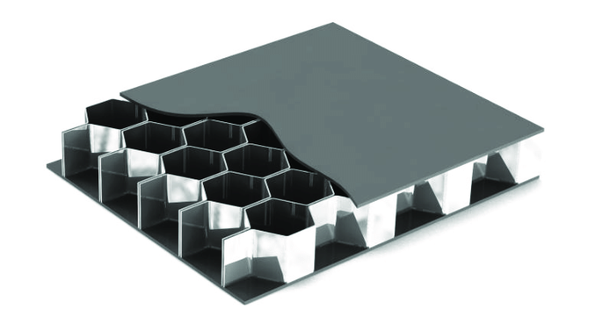
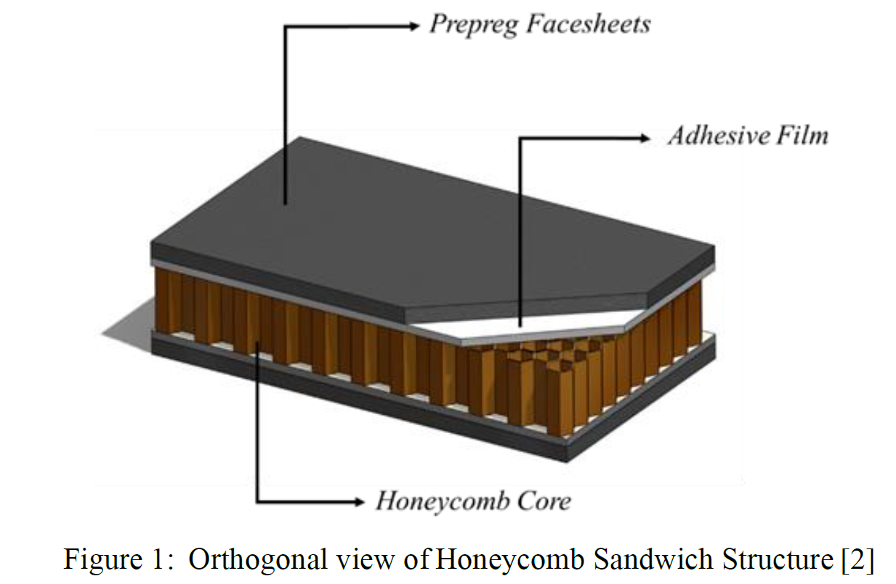
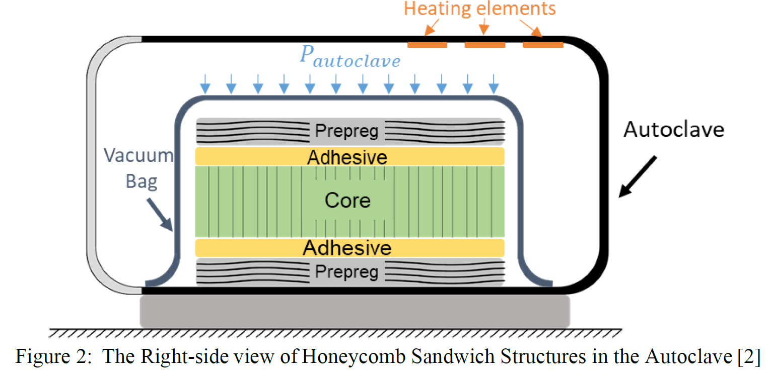
problem ?? solution ??
Leveraging the advantages of Machine Learning (ML), we aim to apply ML to Design Co-cure Processing of Energy-Efficient Honeycomb Sandwich Composite Structures, by discovering the underlying correlations of parameters in physical phenomena and models.
The final goal is to apply machine learning methods on a data sets to find the underlying physics in the Co-cure processing of energy-efficient Honeycomb Sandwich Structures
[2]. Gustavo M. Hobold, Alexandre K. da Silva, Machine learning classification of boiling regimes with low speed, direct and indirect visualization

Slide 4
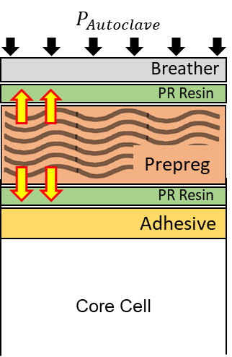
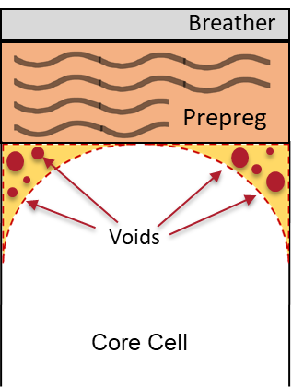
Physical Processes
During co-cure process of sandwich structures, different phenomena occur simultaneously:
(A) Prepreg Face sheet Consolidation
(B) Bond-line Porosity Development
Notes:
So, in a co-cure proces of sandwich structure, we observe 4 phenomena. So when the stack of prepreg facesheet, adhesive, and the core is in the autoclave, we notice

Slide 5
objectives
Identify the governing process parameters in each phenomenon.
Understand the interactions of different phenomena in the co-cure process.
Build a machine learning model to design new cure cycles
To predict and optimize the face sheet consolidation level and bond-line porosity
Notes:
So, now what are our objectives from this data? From the dataset, we'll try to

Slide 6

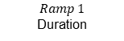
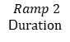
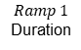
dataset
1800 data points
Source: ASC Student Simulation Challenge database 2021
Dataset
Single Heat Ramp Cycle (Cycle 1 – Cycle 451)
Double Heat Ramp Cycle (Cycle 452 – Cycle 1800)
$$Ramp 1$$
Duration
$$Ramp 1$$
Duration
$$Ramp 2$$
D$uration$
$$Heat Rate 1$$
$$AutoclaveStart Time$$
$$Heat Rate 2$$
$$AutoclaveStart Time$$
$$Heat Rate 1$$
$$Vacuum Start Time$$
$$Vacuum Start Time$$
$$Vacuum Pressure$$
$$Vacuum Pressure$$
[3] https://drive.google.com/drive/folders/1SYFtuoHZkBzpNWDHULUxAuvstTI3VjNU

Slide 7
Methodology
Data Selection
Data Processing
Training Phase
Testing Phase
Optimization
9/12 Input Parameters
6 Output Parameters
Discarded unchanged parameters.
Feature selection from Pearson Correlation Matrix.
Train-Test Split
Train Multiple Linear Regression model
Train using Gradient Boosting
Test trained model
Optimize the Multiple Linear Regression model using backward elimination
Notes:
Since our objective is to build a tool/Objective Function, based on the provided data, to design new cure cycles and to predict the face sheet consolidation level and bond-line porosity of the co-cured sandwich structure, we will be taking a regression approach.

Slide 8




Approach
We aim only to target outputs: Facesheet consolidation & Bond-line porosity to design co-cure process.
Split dataset into 2. With/Without Heat rate 2.
Coupling relation found using Pearson correlation matrix. 12/9 inputs with the 6 output parameters.
Influencing factors of +/- 0.25 correlations are only considered for study.
Ex: Max. Vf ; Autoclave Pressure & Vacuum Pressure are the contributing factors.
Facesheet consolidation; influenced by Max. Vf ( Autoclave and Vacuum Pressure)
We run a Multiple Linear regression model to predict the new cycles and GUI is created.
We run Gradient boosting model to predict new cycles and GUI is created.
Optimization of the Regression model using Backward Elimination.
Optimization
Notes:
Since our objective is to build a tool/Objective Function, based on the provided data, to design new cure cycles and to predict the face sheet consolidation level and bond-line porosity of the co-cured sandwich structure, we will be taking a regression approach. As the Lasso regression yields sparse models, it can thus be used to perform feature selection
Elastic-net is useful when there are multiple features which are correlated with one another
Lasso is likely to pick one of these at random, while elastic-net is likely to pick both.

Slide 9
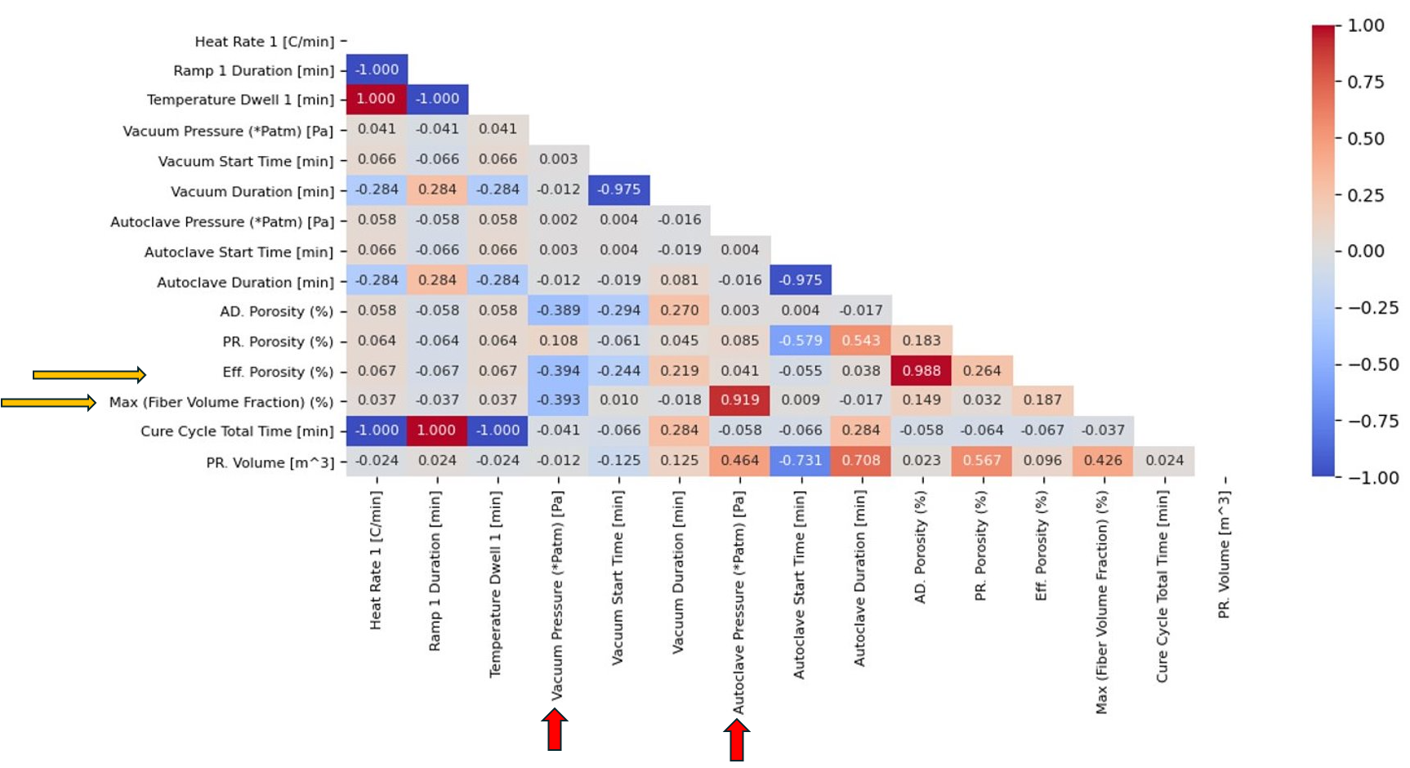
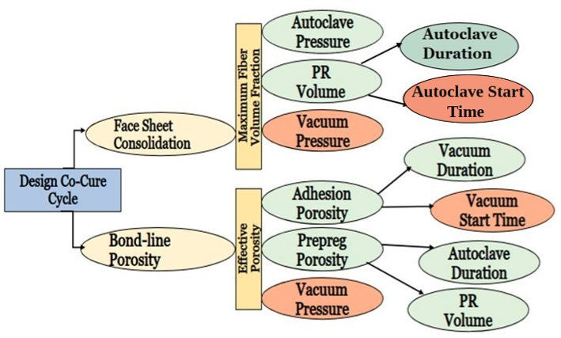
Governing Parameters
Notes:
So, in a co-cure proces of sandwich structure, we observe 4 phenomena. So when the stack of prepreg facesheet, adhesive, and the core is in the autoclave, we notice

Slide 10
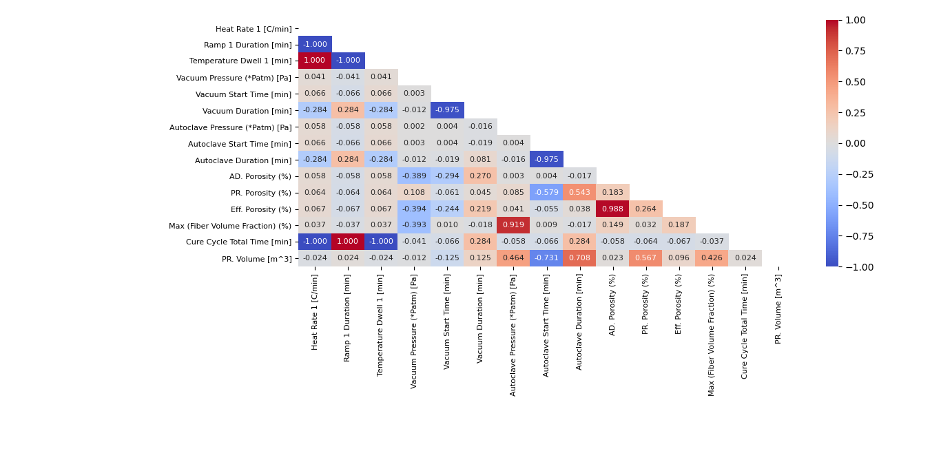
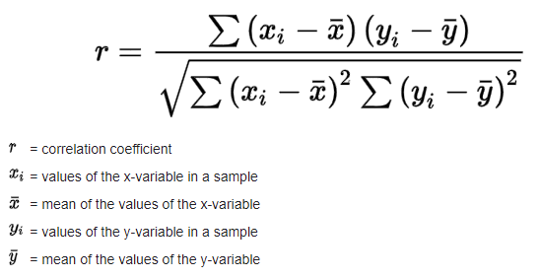
FEATURE SELECTION – Pearson's corelation – 1 HEAT RAMP

Slide 11
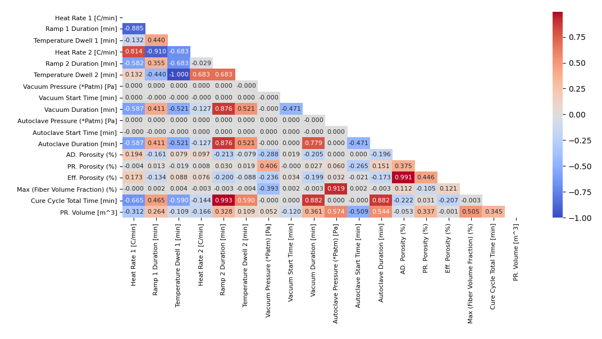
FEATURE SELECTION – pearson’s correlation – 2 HEAT RAMP

Slide 12
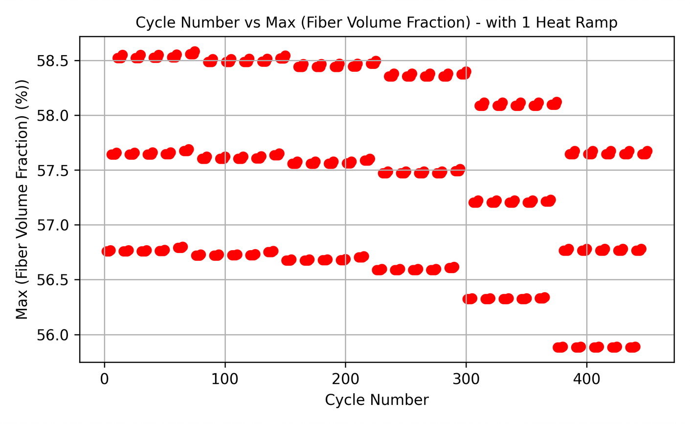
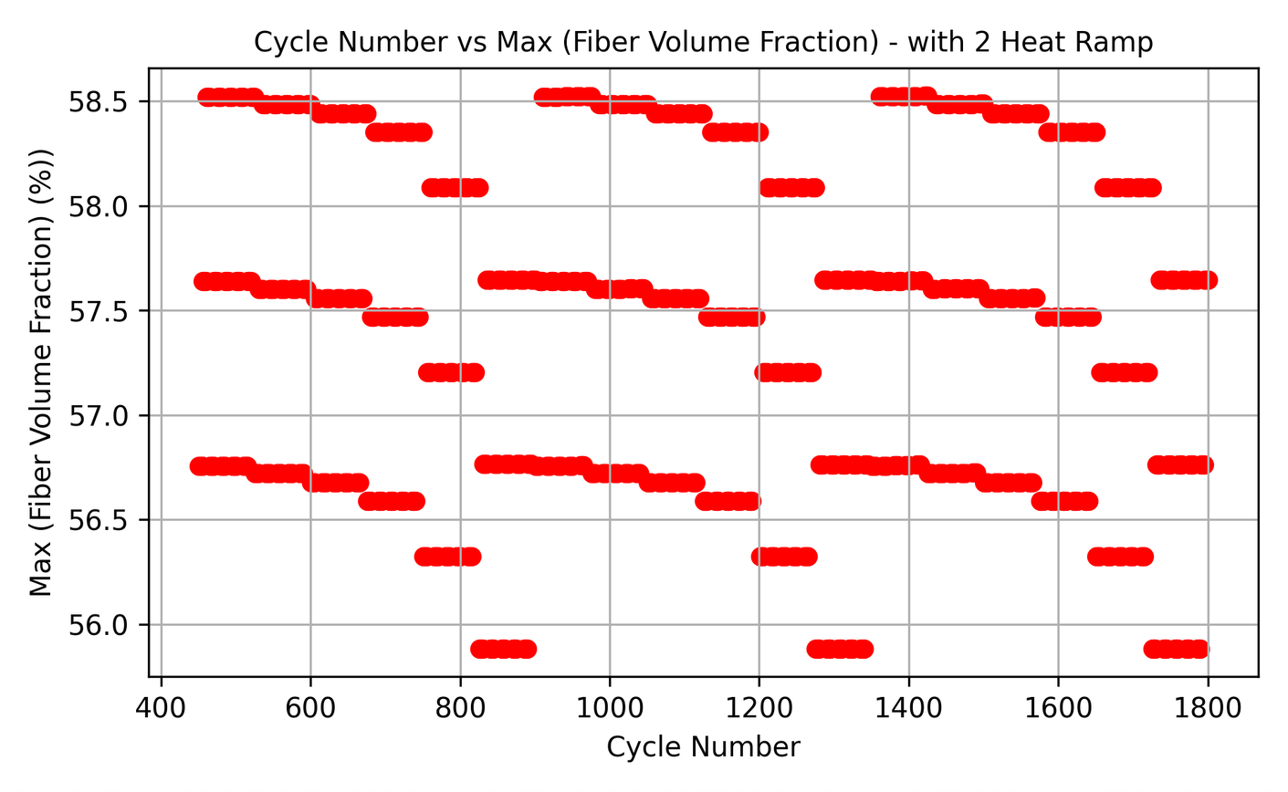
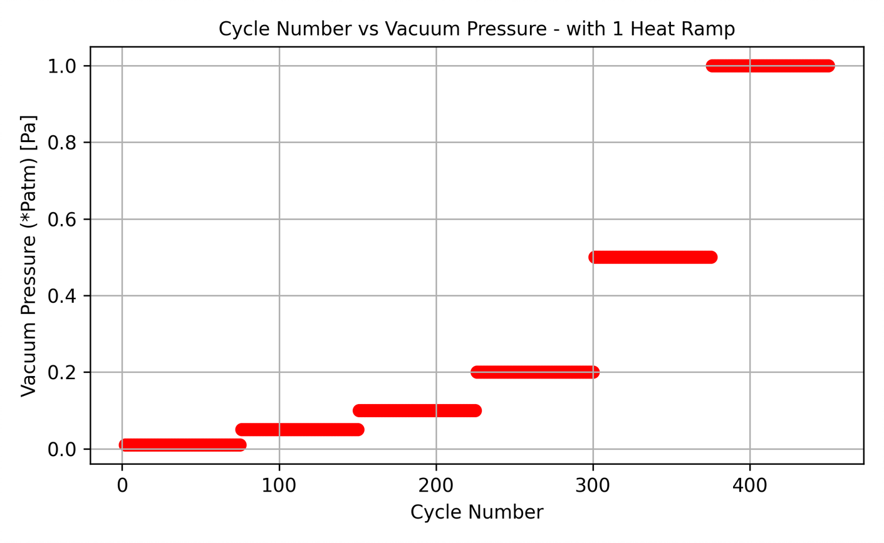
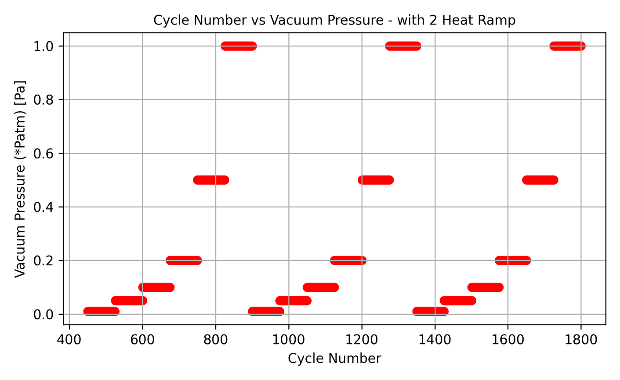

Representation of data set

Slide 13
APPROACH
Dataset
Single Heat Ramp Cycle (Cycle 1 – Cycle 450)
Double Heat Ramp Cycle (Cycle 451 – Cycle 1800)
Train-Test Split
Gradient Boosting
Feature selection
Predict PR Porosity
Predict AD Porosity
Multiple Linear Regression
Multiple Linear Regression
Predict Max Vf
Predict Eff. Porosity

Slide 14
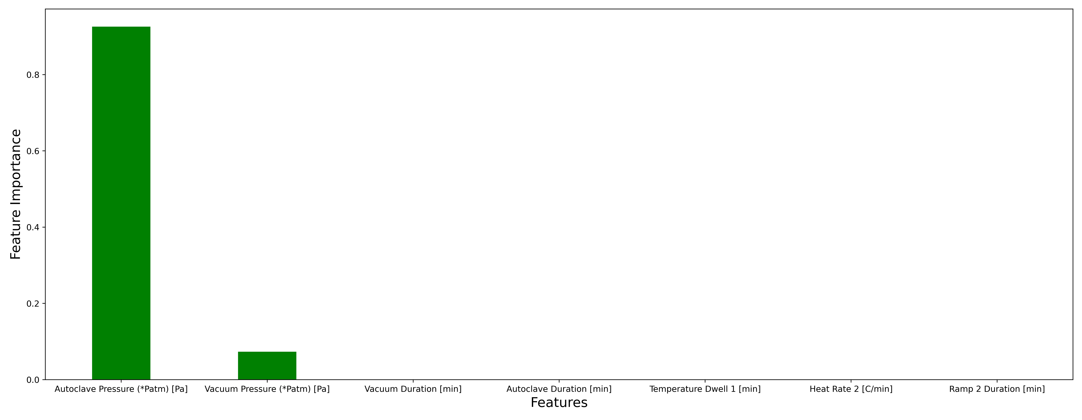
RESULTS - Feature Importance plots – Max Vf

Slide 15
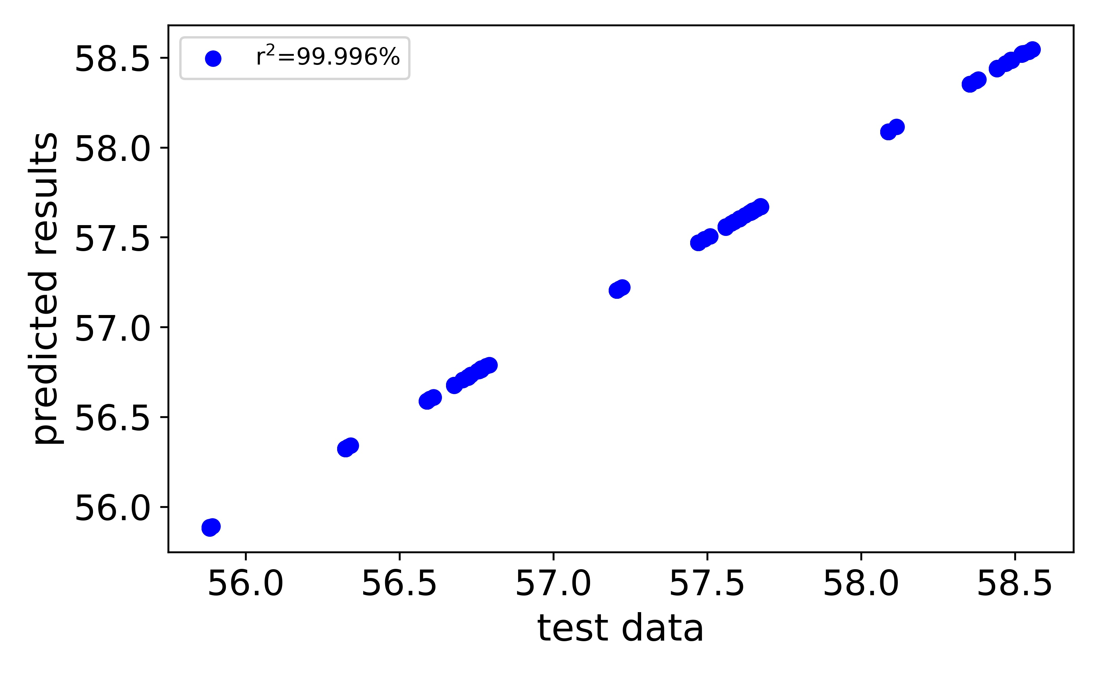
Predicted results vs. Test data – Max Vf
Parameters | Results
R2 score | 0.9999
MSE | 0.0329
RMSE | 5.3428e-06
MAE | 0.0010

Slide 16
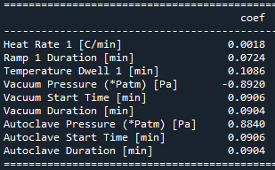
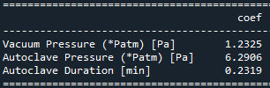
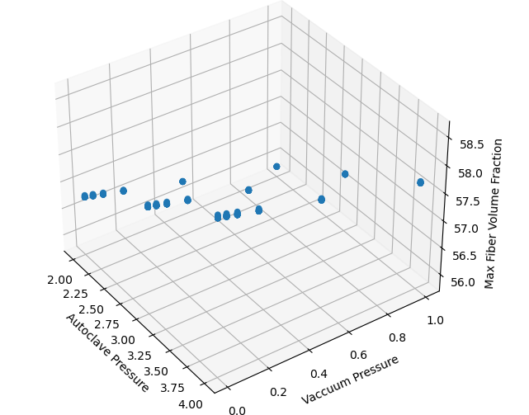
Optimizing linear regression model – 1 HEAT ramp – Max Vf
Before
After

Slide 17
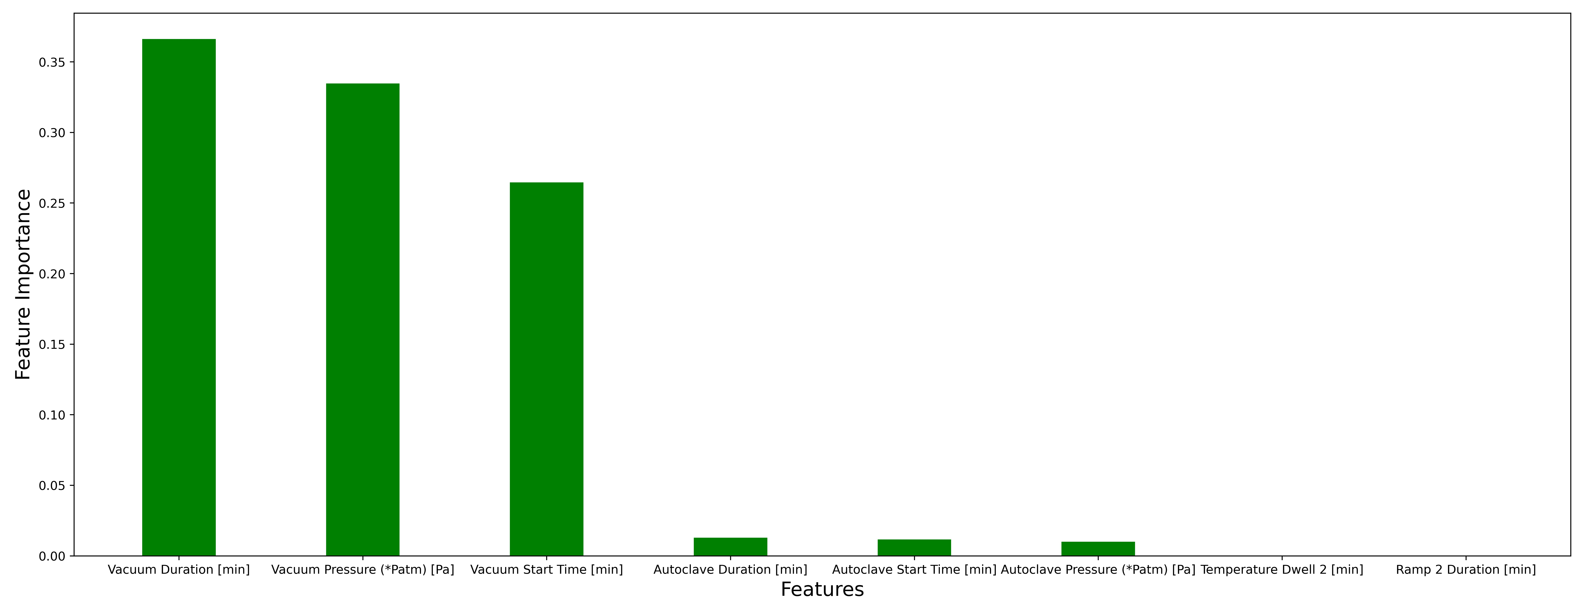
Feature Importance plots – Eff Porosity Single Heat Ramp

Slide 18
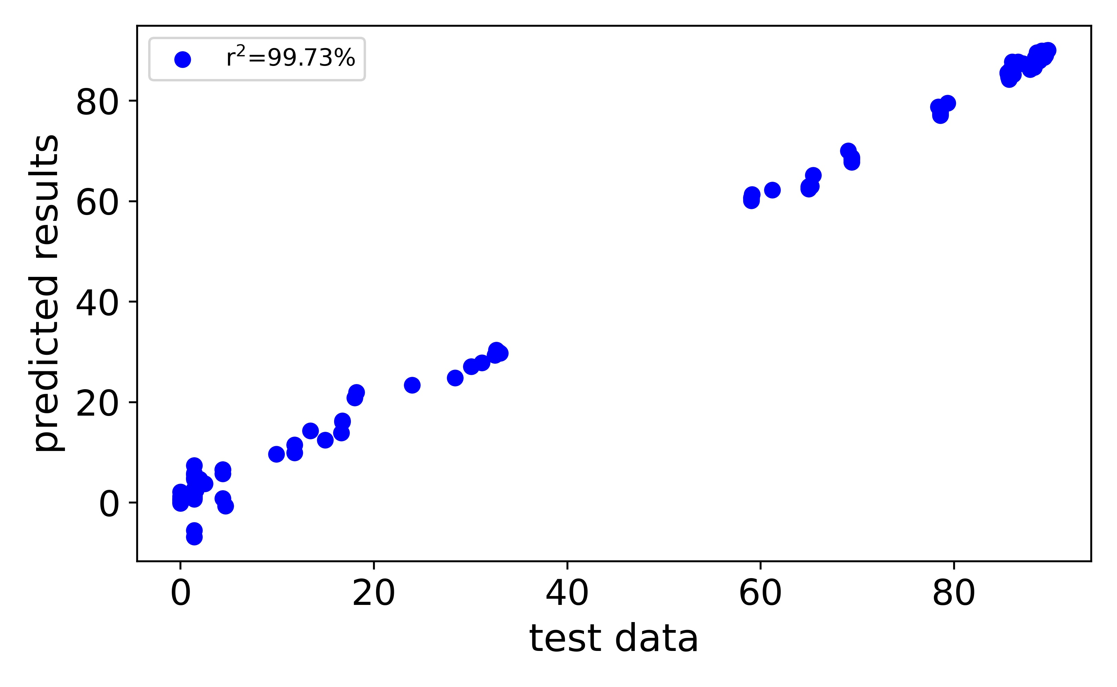
Predicted results vs. Test data – EFF Porosity Single Heat Ramp
Parameters​ | Results​
R2 score​ | 0.9973
MSE​ | 2.418
RMSE​ | 1.555
MAE​ | 1.157

Slide 19
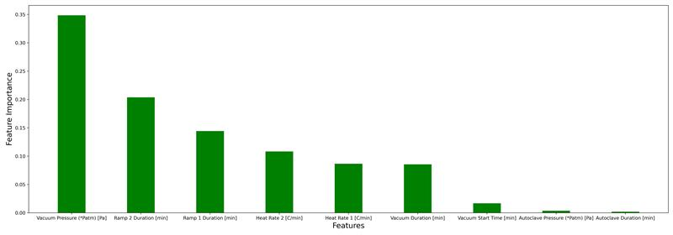
Feature Importance plots – Eff Porosity 2 Heat Ramp

Slide 20
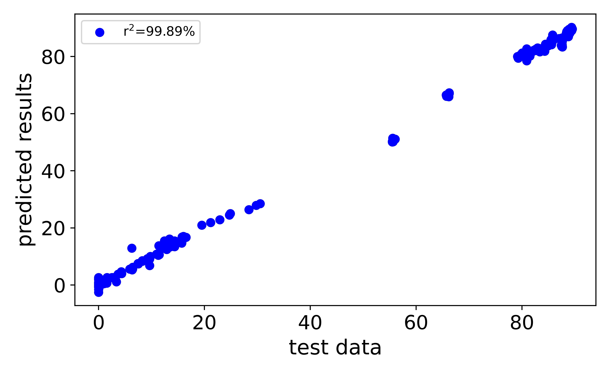
Predicted results vs. Test data – EFF Porosity – 2 HEAT RAMPS
Parameters​ | Results​
R2 score​ | 0.9989
MSE​ | 1.672
RMSE​ | 1.293
MAE​ | 0.763

Slide 21
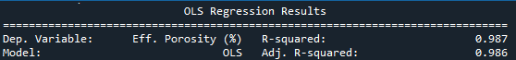
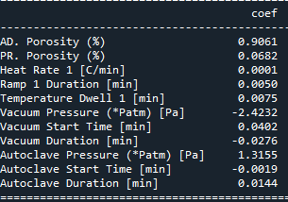
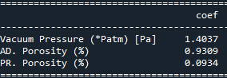
Optimizing linear regression model – 1 heat ramp – eff. porosity
Before
After

Slide 22
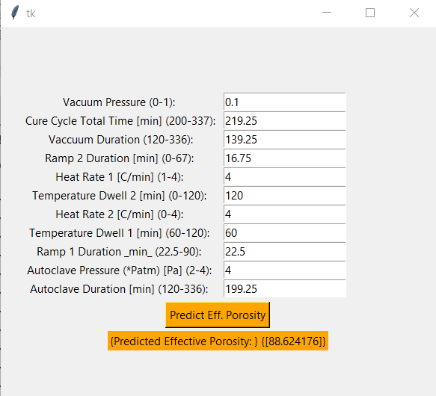
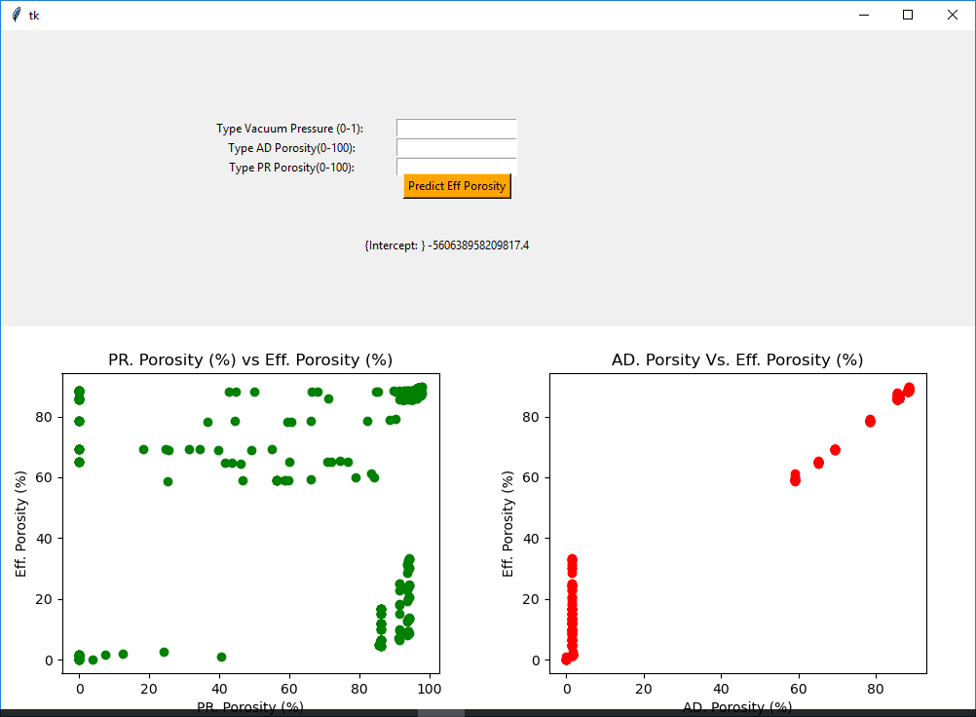
GUI TO PREDICT NEW CO-CURE CYCLES

Slide 23
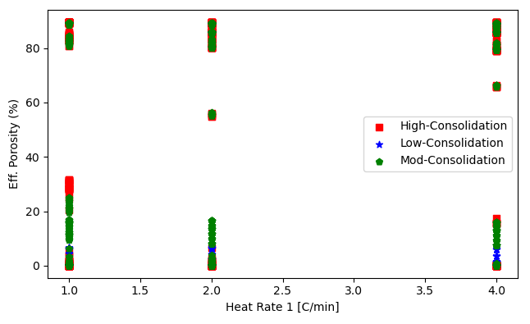
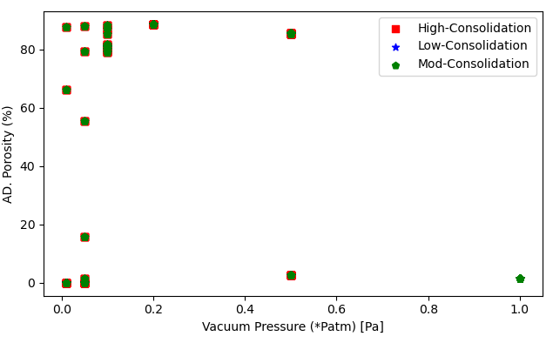
Challenges

Slide 24
References
[1]Navid Niknafs Kermani, Pavel Simacek, Suresh G. Advani “A Simple Analysis Tool to Simulate Honeycomb Sandwich Structure Composites During Co-Cure Manufacturing Process”Proceedings of the SAMPE 2019 Conference, Society for the Advancement of Material and Process Engineering(2019)
[2] Centea, T., Simacek,P., Anders,M., Niknafs Kermani, N., Zebrine,D.,Advani,S.G.,and Nutt. S. ”Understanding and modeling the co-cure of honeycombcore sandwich structures” Proceedings of the SAMPE 2019 Conference, Society for the Advancement of Material and Process Engineering (2019)
[3] Kermani, N. N.; Simacek, P.; Advani, S. G. Porosity predictions during co-cure of honeycomb core prepreg sandwich structures. Compos. Part A: Appl. Sci. Manuf. 2020, 132, 105824
[4] Centea T, Anders M, Zebrine D, Nutt S, Angeles L. The co-cure of honeycomb sandwich structures: process physics and manufacturing strategies. In: 18th European conference on composite materials (2018), June; 2018. p. 24–28.
[5] Campbell FC. Chapter 8 -adhesive bonding and integrally cocured structure: a way to reduce assembly costs through parts integration. In: F.C.B.T.-M.P. for A.C. Campbell, editor. Amsterdam: Elsevier Science; 2004. p. 241–301.

Slide 25
Thank you! Questions?

